Slide 1

Team Name: Tetra techies
Team Members:
Sushma S (Team leader)
2. Trishala Pandi S
3. Sarnitha M
4. Seraphine T
CSE
CSE
IT
IT
III
III
III
III

Slide 2
Personalized Renewable Energy Siting Platform

Slide 3
Problem statement
Developing a personalized renewable energy recommendation platform that recommends suitable renewable energy options, such as solar panels and wind turbines, etc. for individuals or businesses based on their location, energy needs, square feet of area and budget. The platform utilizes open-source data on renewable energy potential and costs to provide users with accurate and relevant recommendations. Our goal is to promote the adoption of renewable energy sources and reduce carbon emissions, contributing to a more sustainable and environmentally friendly future.

Slide 4
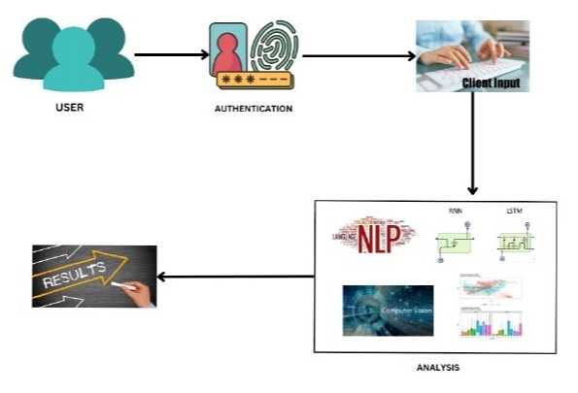
WORKFLOW

Slide 5
Ideas & approaches
The account initiation process requires users to provide essential information and create a secure password, granting them comprehensive access to our diverse platform.
Our customized dashboard seamlessly integrates real-time data from Global Solar Atlas, LatLong.Net, Global Wind Atlas , allowing for precise evaluation of various energy resources potential tailored to users' geographic coordinates.
Users are encouraged to provide insightful inputs or smart-meter data to understand electricity consumption dynamics and anticipate future energy needs while setting a budget for installation.
The advanced deep learning algorithms, including KNN and Gradient Boosting model, decode complex temporal nuances in energy consumption and renewable energy generation data, providing valuable insights into the viability and financial efficacy of various renewable energy options.
The integration of a refined chatbot framework, powered by NLP methodologies, distills user inquiries and preferences into tailored recommendations, enhancing comprehension and facilitating informed decision-making.

Slide 6
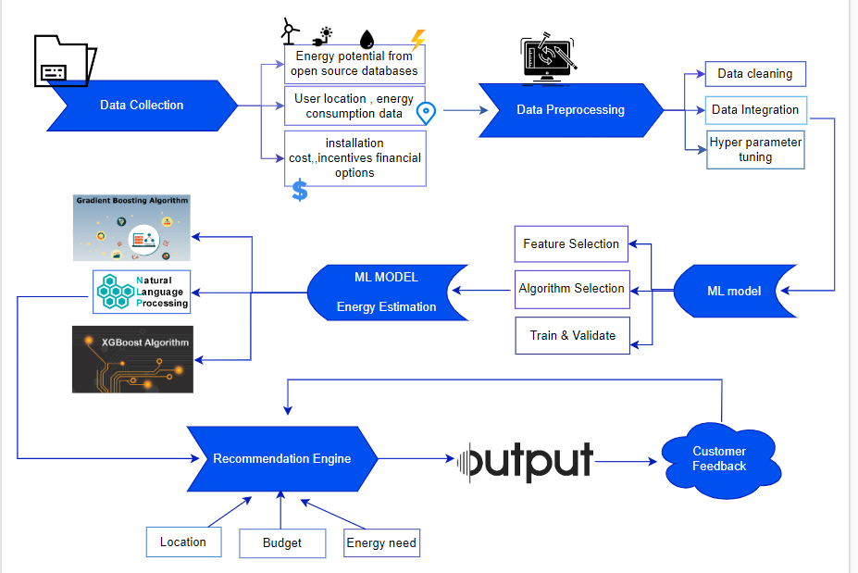
ARCHITECTURE DIAGRAM

Slide 7
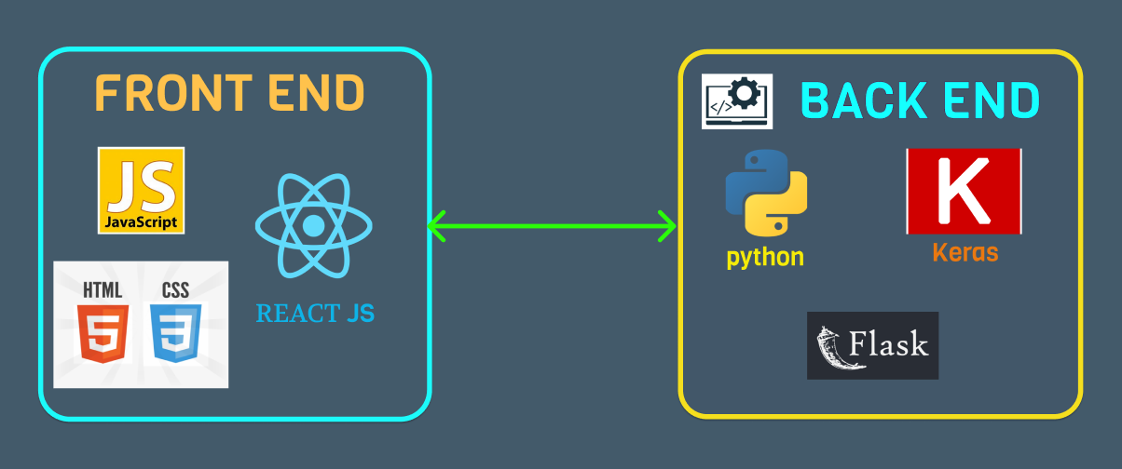
Tech Stack
Algorithms :
Gradient Boosting Model
XGBoost
KNN
Stacking Classifier

Slide 8
SWOT ANALYSIS
S
W
O
T
The platform offers personalized recommendations based on location, energy needs, square footage, and budget.
Leveraging open-source data enhances the accuracy and relevance of recommendations.
The platform contributes to reducing carbon emissions and fostering a more sustainable future.
Dependence on open-source data may lead to inaccuracies, affecting the reliability of recommendations.
Users may lack awareness of the platform's existence or the benefits of renewable energy, requiring robust marketing.
The platform has the potential for global scalability, allowing it to address renewable energy needs beyond its initial target market.
Collaborating with renewable energy providers, government agencies, and environmental organizations can expand the platform's reach and credibility.
The renewable energy sector is competitive.
Changes in government policies and regulations related to renewable energy incentives and subsidies could impact the platform's viability and profitability.
OPPORTUNITIES
STRENGTHS
THREATS
WEAKNESSES

Slide 9
MARKET ANALYSIS
Increasing awareness of environmental issues and government incentives for renewable energy adoption create a favorable market.
Collaborating with renewable energy providers, government agencies, and environmental organizations can expand the platform's reach and credibility.
The platform has the potential for global scalability, allowing it to address renewable energy needs beyond its initial target marke

Slide 10
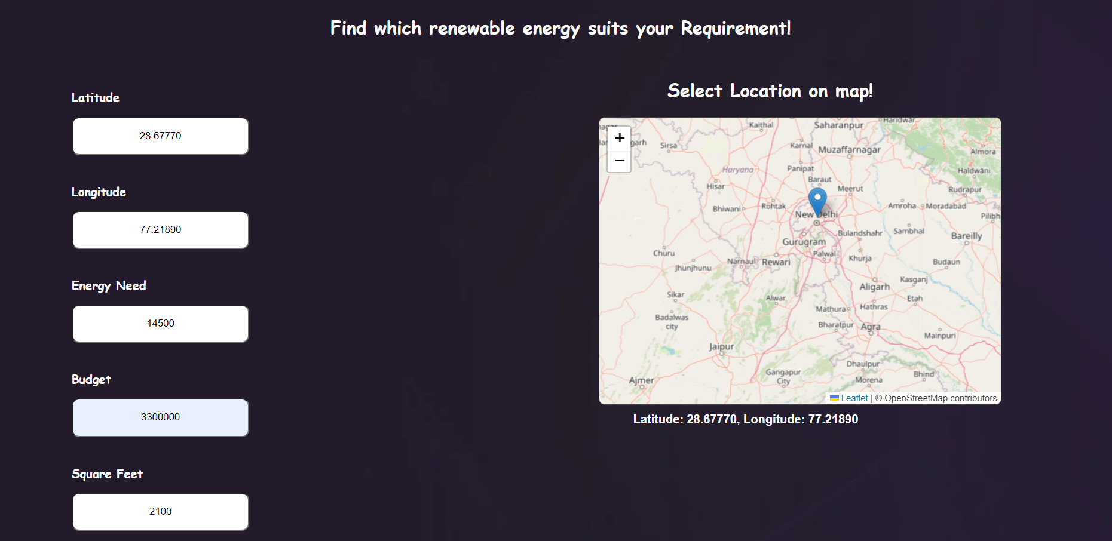
SAMPLE OUTPUT

Slide 11
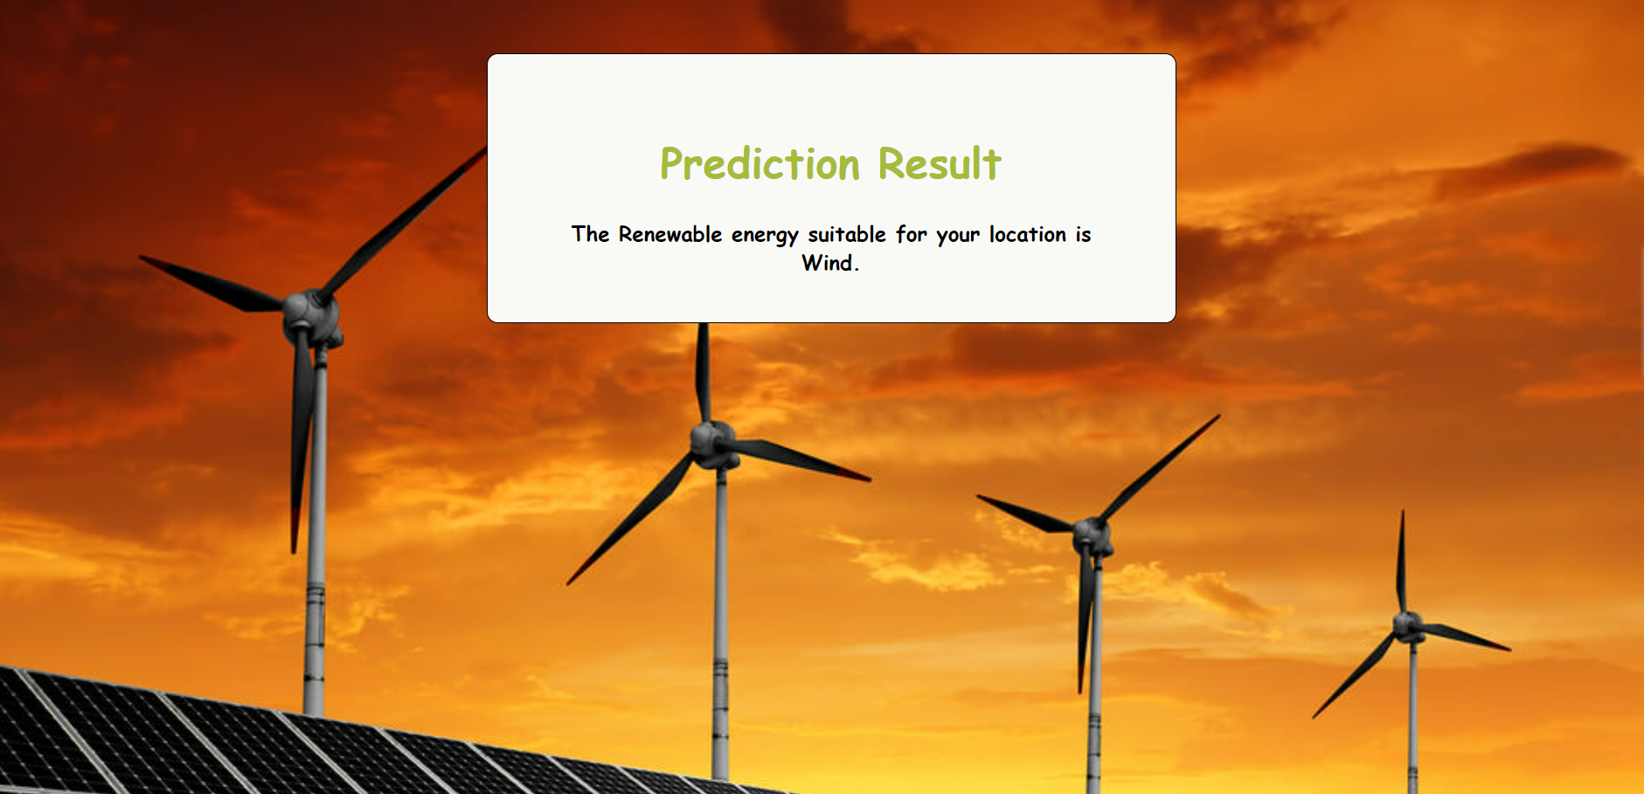
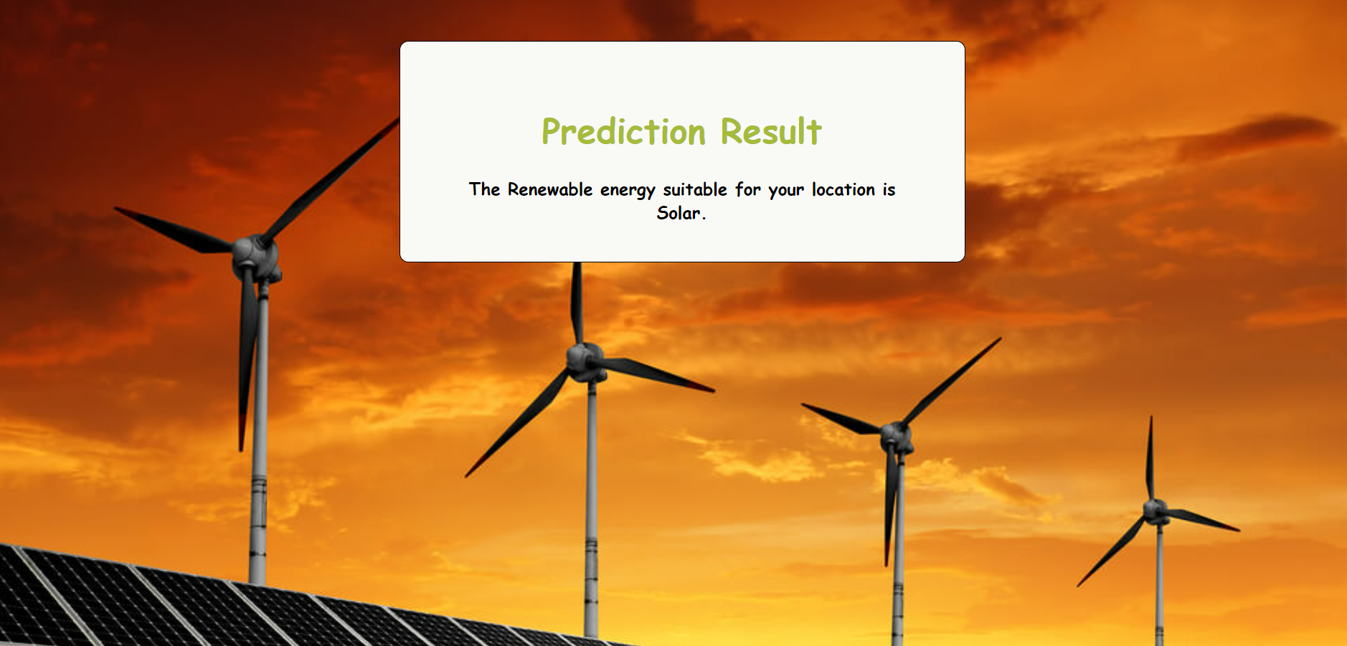


Slide 12
Thank you

